Slide 1
Predicting Voter Turnout Rate In Pennsylvania
Team SLAK
Shaogu (Shawn) Lu, Liufei Chen, Zhixuan (Alex) Jiang, Kanika Selvapandian

Slide 2
Table of Contents
01
02
03
Introduction
Data Collection
Data Cleaning
Background and Motivation
API, CSV and Web Scraping methods
Consolidation of Data for Analysis
04
05
06
Visualization
Regression
Future Work
Visualizing relations between variables
Predictive and validation of model
Possible pathways to extend our project

Slide 3
01
Introduction

Slide 4
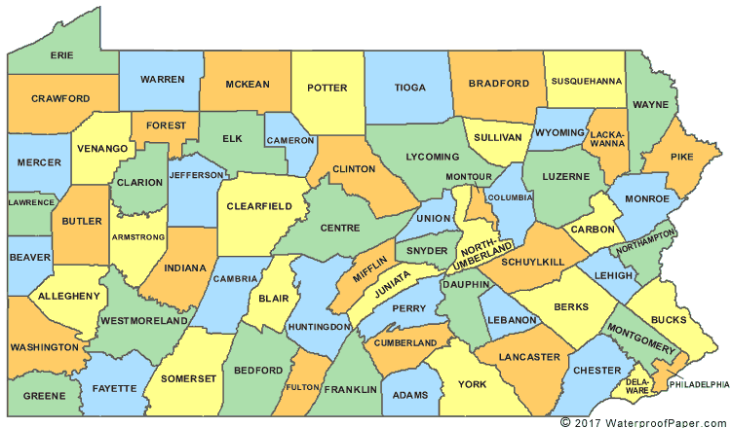
Background and Motivation
Low voter turnout rates in America
How socioeconomic and demographic variables impact voter participation.
The existing literature, which focuses on individual-level data and relies heavily on self-reported surveys, which may have self-reporting errors, social desirability bias, selection bias, and challenges with population representativeness.
Our county-level data avoid these issues

Slide 5
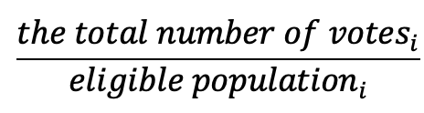
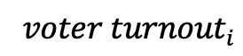
Dependent Variable
=
2016 presidential election (n = 67)
2020 presidential election (n = 67)

Slide 6
Independent Variables
1
2
3
Education
Employment
Gender
4
Ethnic Groups
5
6
Income
Partisanship
7
Urban/Rural

Slide 7
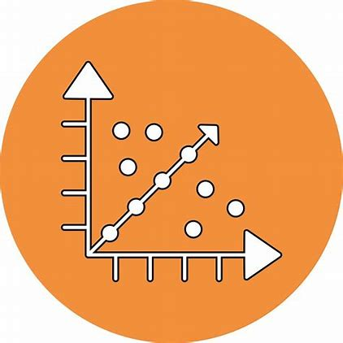

Regression Models
Linear Regression
Panel Regression

Slide 8




Research Objectives
Data Collection
Data from Pennsylvania counties for presidential elections from 2016 and 2020
Correlation Analysis
Analyze the relationship between voter turnout rates and socioeconomic variables
Predictive Insights
Provide data-driven insights into the most critical factors for predicting voter turnout
Tool for Decision-Makers
Create a practical tool for policymakers, political analysts, and researchers

Slide 9
02
Data Collection

Slide 10
Data Sources
Data
Sources
1
API
Commonwealth of Pennsylvania Elections Results
Voting Results, Partisanship
Demographics
[Sex, Race, Citizenship, Income, Education, Employment Rate]
US Census Bureau
2
CSV
Diversity Index
PA State Data Center
3
Web Scraping
Area of Each County
Center for Rural Pennsylvania

Slide 11
03
Data Cleaning

Slide 12
Formatting and Compiling Data
API
Web Scraping
CSV
Retrieve JSON data from API link and convert it into a dataframe
Retrieve HTML code through form submit and convert into a dataframe
Reformat CSV files to desired format: (County, Year) as index
Export dataframe to csv for future use
Export dataframe to csv for future use
Store new CSV for future use
Merge all columns into one dataset with (County, Year) being the matching attribute
Clean Data

Slide 13
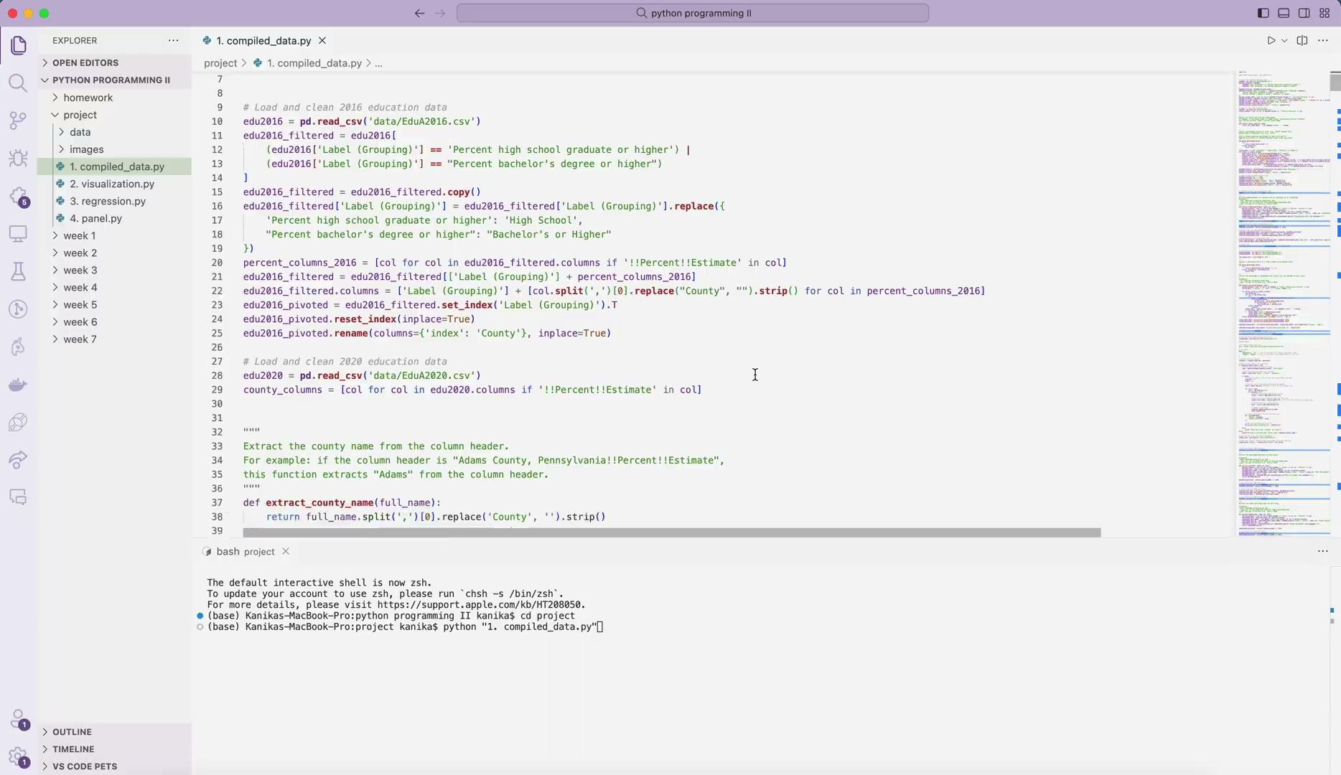
Demo

Slide 14
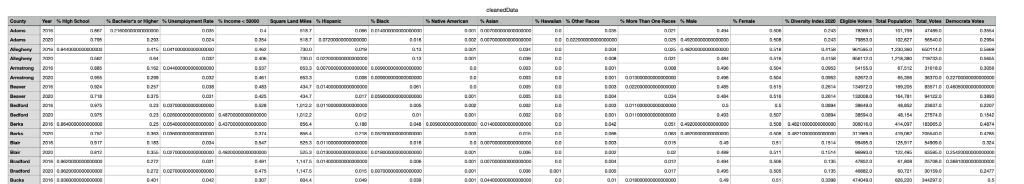
Final Cleaned Data in CSV
134 Rows, 21 Columns

Slide 15





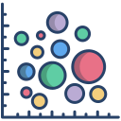


Python Libraries
pandas
numpy
plotly
requests
BeautifulSoup
matplot
re
seaborn

Slide 16





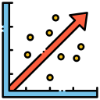
New Libraries Used
geopandas
sklearn
scipy
os
State map of Pennsylvania to show county voter turnout rate
Linear Regression
Calculate r2 square for model performance
Import stats to calculate p-values
Create Image folder if it does not exist for saving plots after analysis
statsmodels
linearmodels.panel
OLS Regression class
Calculate Variance Inflation Factor
Add constants
Used RandomEffects and PanelOLS classes

Slide 17






Python Features Used
Functions
Exception Handling
List Comprehensions
Different Data Types
Modules
In built functions
(e.g., sort)

Slide 18
04
Visualization

Slide 19
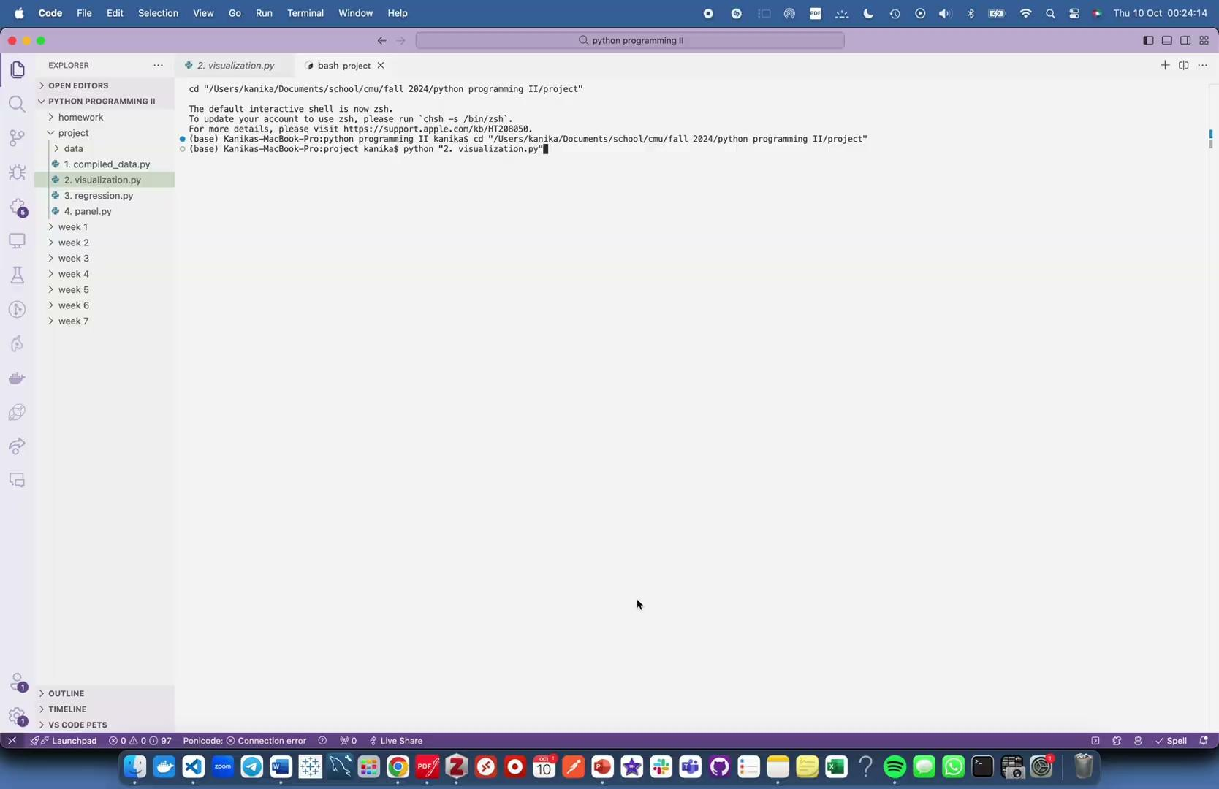
Demo

Slide 20
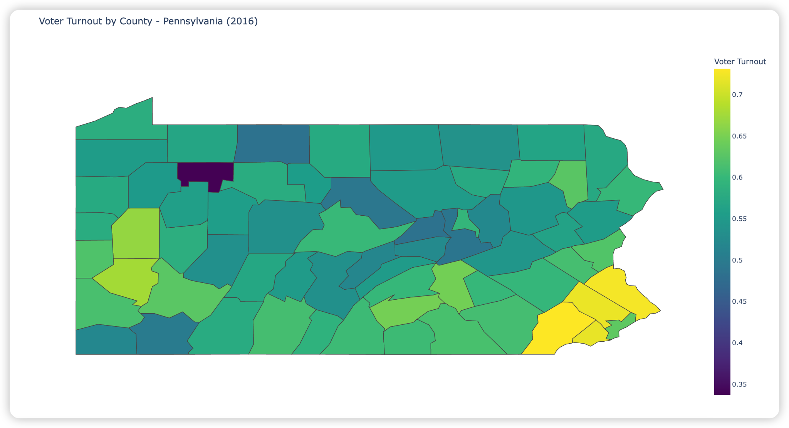
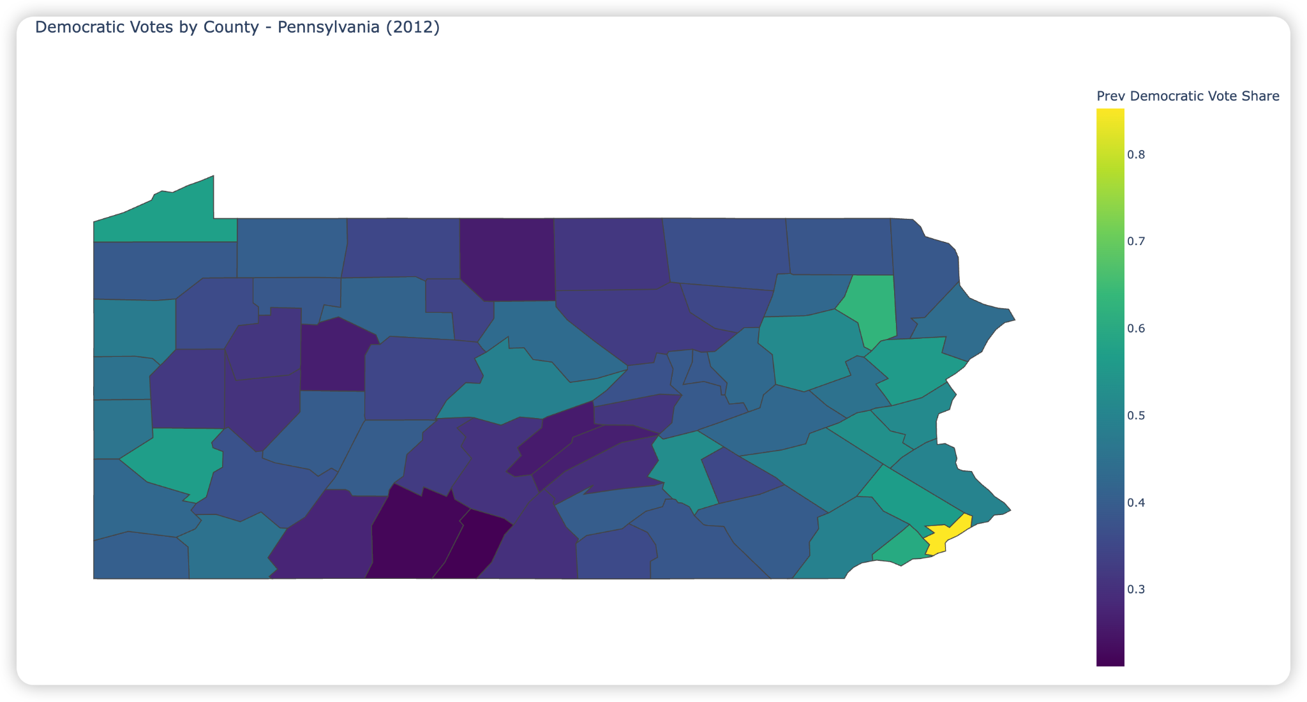
Voter Turnout Rate 2016 vs Democratic Vote Share 2012
The turnout rate is positively correlated with the democratic votes in the previous election year.

Slide 21
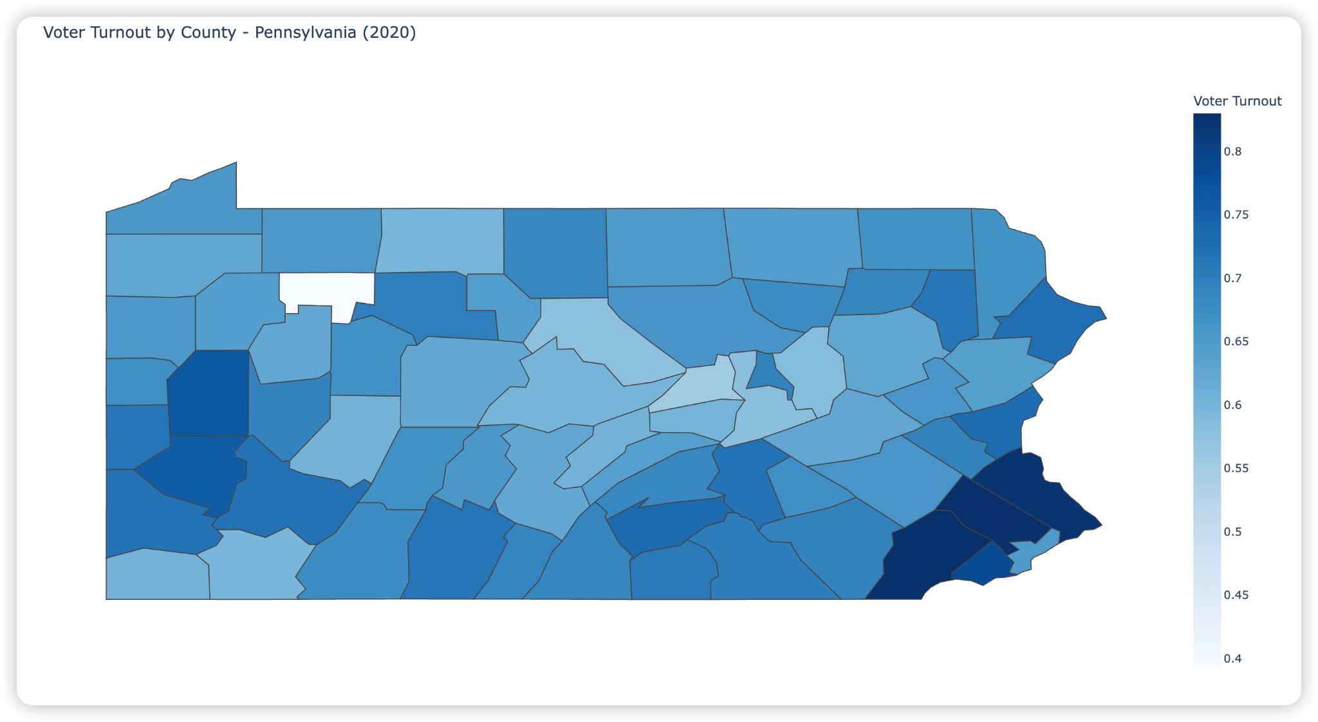
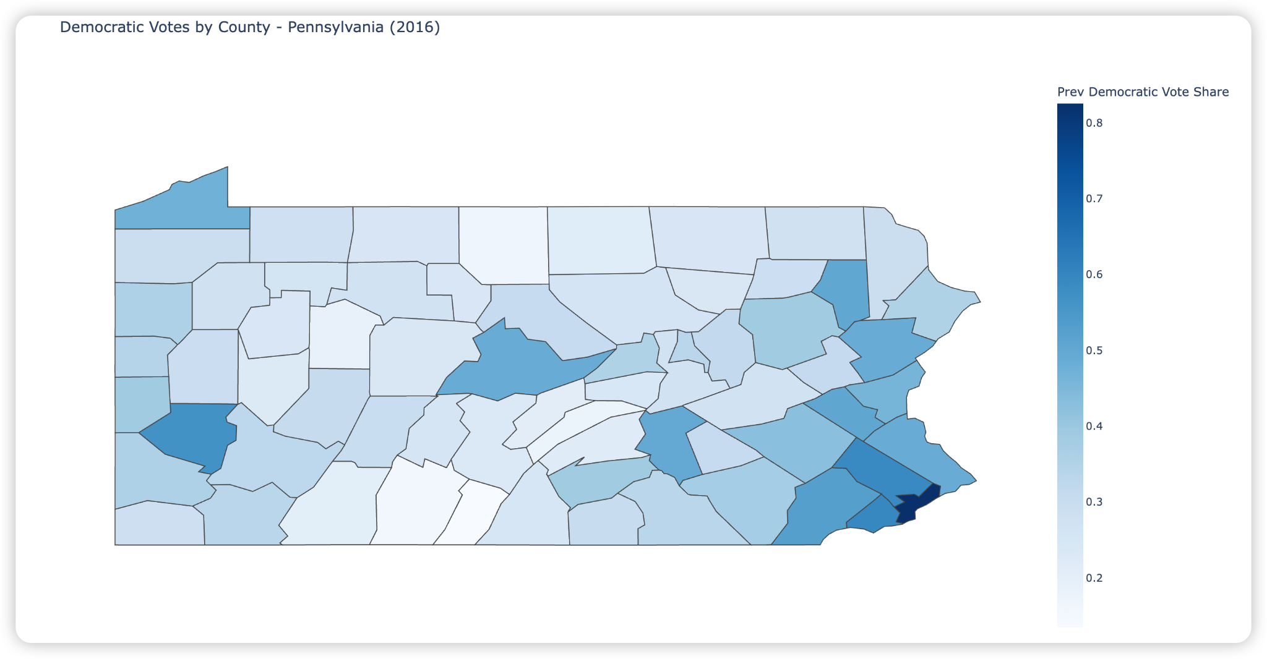
Voter Turnout Rate 2020 vs Democratic Vote Share 2016
The turnout rate is positively correlated with the democratic votes.

Slide 22
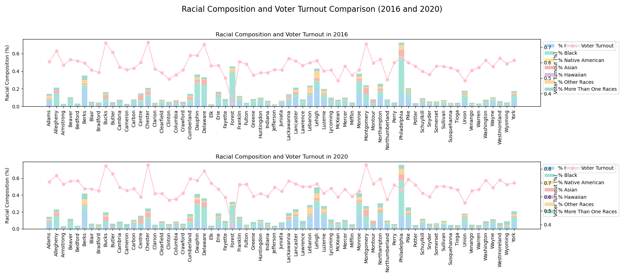
Racial Composition vs Voter Turnout Rate
Counties with higher racial diversity appear to be inversely proportional to voter turnout compared to less diverse counties

Slide 23
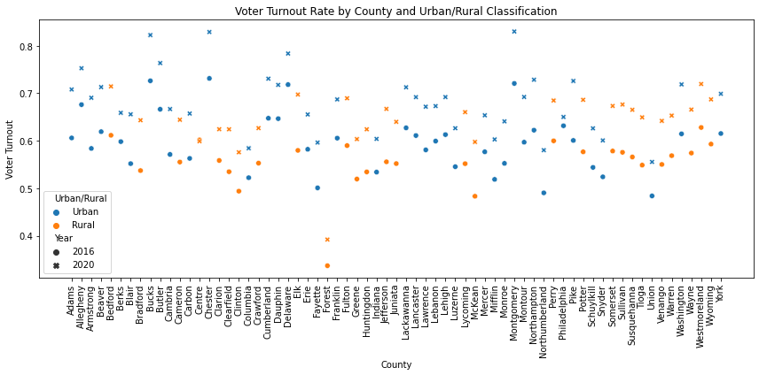
Voter Turnout Rate by County and Urban/Rural Classification
More blue points scattered on the top compared to the bottom
Which shows Urban counties tend to have higher voter turnout rates

Slide 24
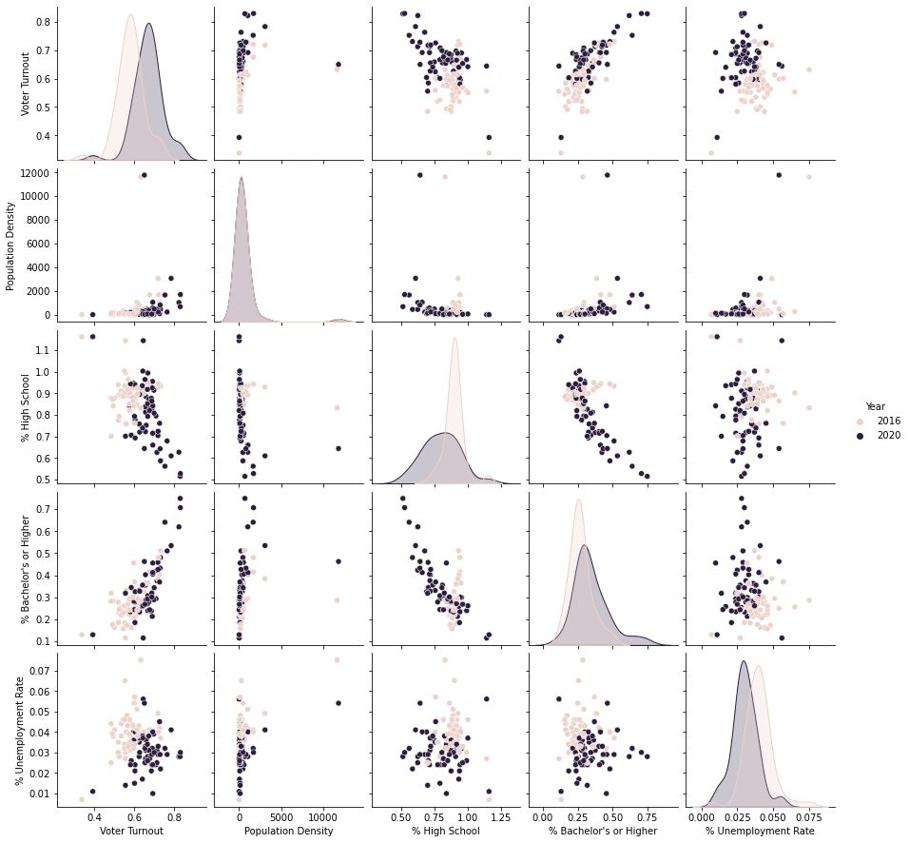
Pairplot
Overall Increase in Voter Turnout
Voter Turnout positive correlated with population density and education level

Slide 25
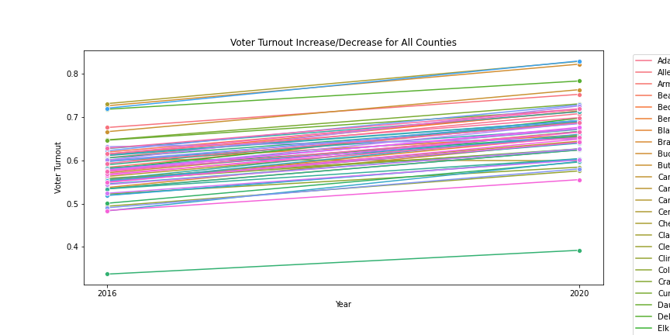
Voter Turnout Increase/Decrease per county
Overall Increase in Voter Turnout
Chester has the highest turnout rate
Forest has the lowest turnout rate

Slide 26
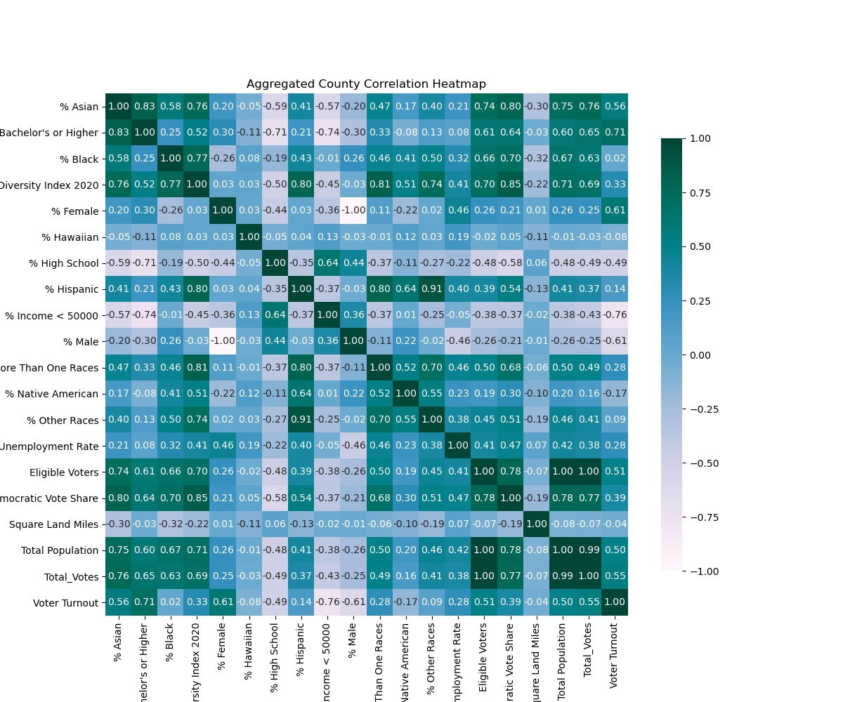
Aggregation County Correlation Heatmap
Aggregating by county averages the data within each county
Key Findings
Positive correlation between having a Bachelor’s or Higher degree and Voter Turnout (~0.71)
Income below $50,000 is negatively correlated with Voter Turnout (-0.76)

Slide 27
05
Regression

Slide 28
Regression Models
Linear Regression
Panel Regression
Uses cross-sectional or single-time-period data.
Estimates the relationship between predictors and the outcome at a single point in time.
Uses data that tracks the same entities over multiple time periods.
Analyzes how changes in the independent variables relate to changes in the dependent variable over time within each entity.
Notes:
Panel can track same entities over different time period and it can analysis the unobserved variables in the data

Slide 29
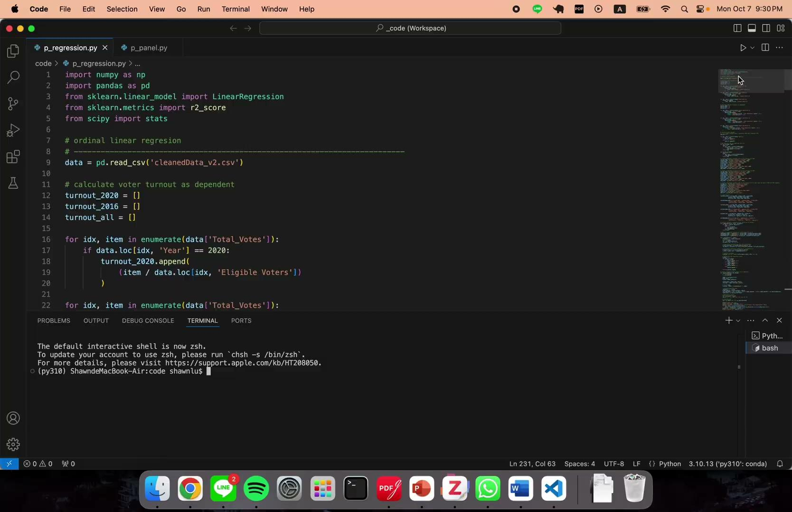
Linear Regression Demo

Slide 30
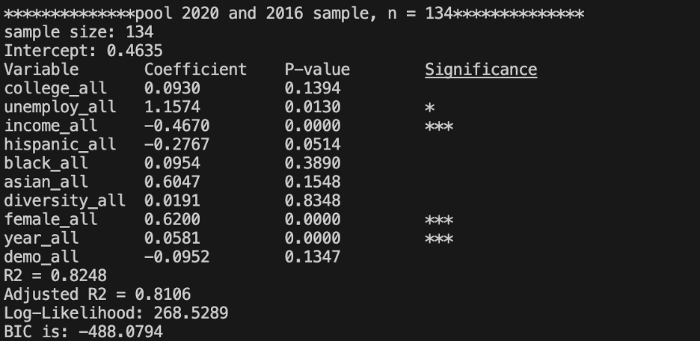
Linear Regression Output
* p<0.05, ** p<0.01, *** p<0.001
Notes:
The less BIC value, the less over fit of the data

Slide 31
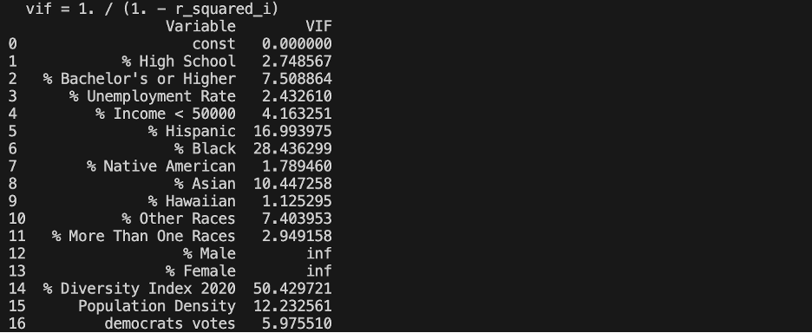
Panel Regression
Variance Inflation Factor (VIF)
Uses to identify multicollinearity among independent variables
High VIF affect the stability of the model's coefficient

Slide 32
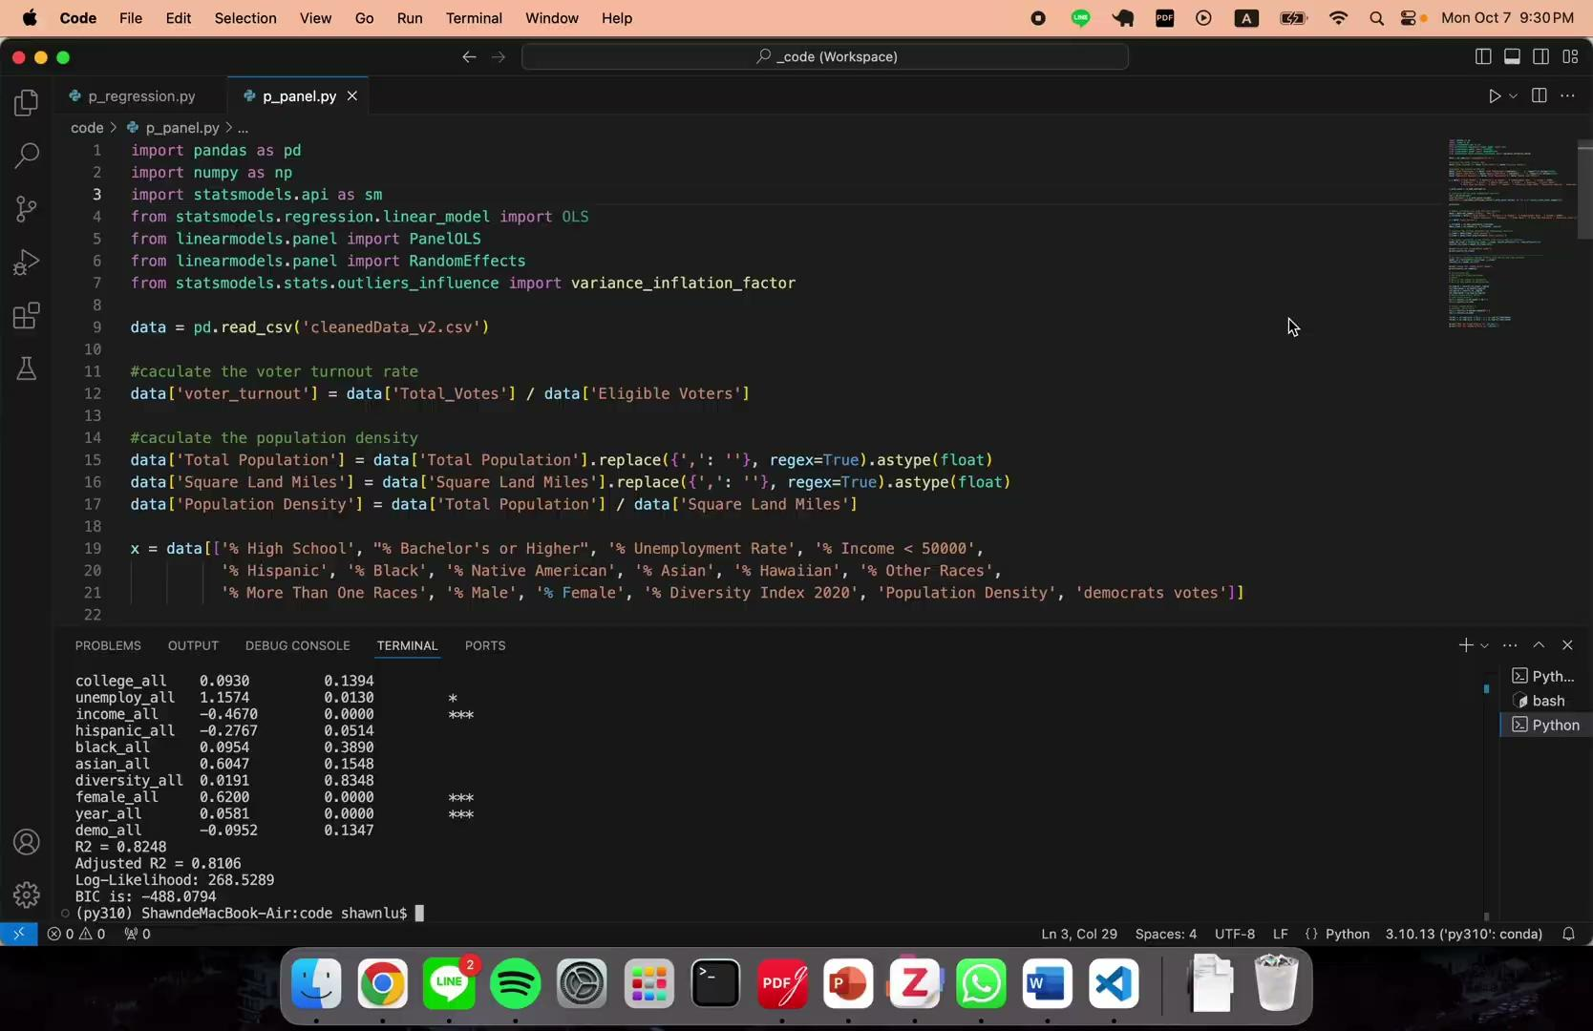
Panel Regression Demo

Slide 33
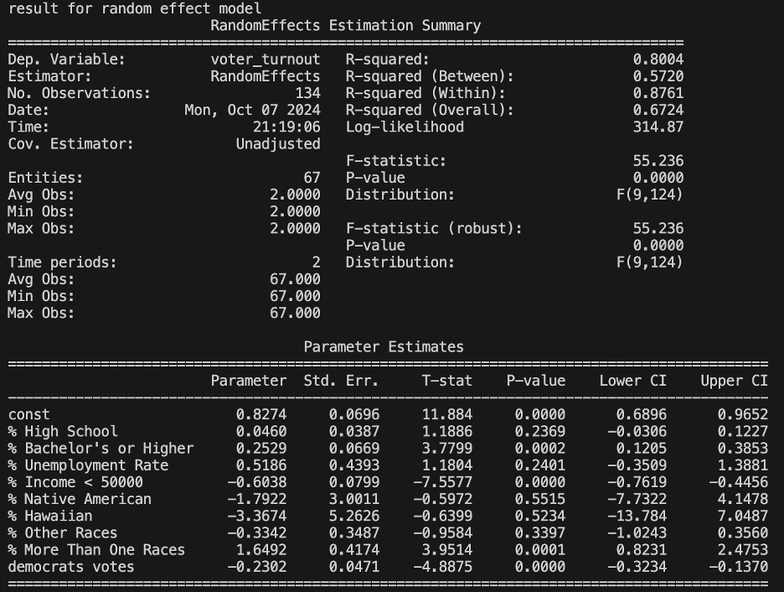
Panel Regression Output
Notes:
The less BIC value, the less over fit of the data

Slide 34
Comparison
Significant Variables Identified
Linear Regression | Panel Regression
% unemployment | % bachelor’s or higher
% income < 50000 | % income < 50000
% female | % more than one races
year_dummy (2020 as 1) | % Democratic Candidate’s Vote Share
Linear Regression | Panel Regression
R²: 0.8248 | R²: 0.8004
BIC: -488.0794 | BIC: -570.9637
Notes:
4 sig variable identified in each model , income in both

Slide 35
06
Future Work

Slide 36


Future Work
Expand the Analysis
Practical Application
Add more factors to see how they impact on the result
Add data from more elections to improve predictability of the models
Create a website or app for users to explore how different variables affect voter turnout and see trends over time

Slide 37
Thank you!

